Slide 1

The Performance of Options-Based Investment Strategies: Evidence for Individual Stocks During 2003─2013
Michael L. Hemler
University of Notre Dame
Thomas W. Miller, Jr.
Mississippi State University
OIC Financial Advisors Forum
Hotel Fontainebleau
Miami Beach, FL
May 8, 2015
U N I V E R S I T Y O F
NOTRE DAME

Slide 2
Prologue: What Motivated This Study?
  In Spring 2013 Alan Grigoletto of the Options Industry Council (OIC) contacted Mike Hemler regarding a potential options research project.
  Alan noted that large pension funds used options to alter the risk-return profile of their investment portfolios, e.g., the Ontario Teachers’ Pension Plan and the New Jersey Public Employees’ Pension Plan
  Alan also noted that existing studies on the performance of option strategies typically focused on covered calls or collars using index (mostly S&P 500) options.
  Alan suggested that large institutional investors would welcome a study that compared the performance of the standard “buy and hold” strategy versus option strategies that include long equity. They would be especially interested in a study that focused on individual stocks, rather than equity indexes.
  See the CBOE website http://www.cboe.com/micro/buywrite/ for references on options-based strategies and benchmark indexes. In addition, see the CBOE March 2015 Risk Management Conference: http://www.cboe.com/rmc/2015/Day-1-Session-2-Speth.pdf and http://www.cboe.com/rmc/2015/Day-1-Session-2-Black-Szado-projector.pdf.
Notes:
That is, no butterfly, box-spreads, straddles, strangles, condors, etc.
Point out relevant info for our study that is at those 3 CBOE links.
With first one, point out risk/return emphasis. Show that underlying is always an index.
With third one, show that authors focus on performance measures like Stutzer, Sharpe, Sortino, etc. (second page)

Slide 3
Introduction
Options are a convenient and effective tool for portfolio managers who want to tailor equity positions, augment income, or limit risk in changing market conditions.
A popular strategy is the covered call (or, buy-write) strategy: it combines a long equity position with a short call position.
  Whaley (2002) examines the CBOE Buy-Write Index (BXM) during 1988-2001, and concludes that “BXM outperformed the S&P 500 portfolio by approximately 0.2% a month on a risk-adjusted basis.”
  Hill, Balasubramanian, Gregory, and Tierens (2006) analyze various S&P 500-overwriting strategies, concluding that such strategies “have very favorable performance characteristics at a range of risk levels.”
  Kapadia and Szado (2007) examine the buy-write strategy on Russell 2000, concluding “the buy-write strategy can outperform the index.”
Notes:
Whaley study commissioned by CBOE before launching its BXM contract. Well done … recommend it. Ditto for the Hill et al paper …. Authors at Goldman Sachs. Nice applied paper!

Slide 4
Introduction
Another popular strategy is the collar: it combines a long equity position, a short call position, and a long put position.
A collar is simply a covered call that adds a long put position.
  The option parts are sometimes known as “split-strike” conversions.
  One can form a “zero-cost” collar, and combined it with long equity.
  The resulting payoff profile resembles a vertical bull spread.
Collar studies include:
  Szado and Schneeweis (2010) analyze collars based on the PowerShares QQQ exchange-traded fund. With their method, they conclude that collars gave superior returns and reduced risk compared to the buy-and-hold strategy.
  Szado and Schneeweis (2012) analyze collars across a range of asset classes, including equity, currency, commodity, real estate, and fixed income. They conclude that “for most of the asset classes considered, an options-based collar strategy … provides improved risk-adjusted performance and significant risk reduction.”

Slide 5
Introduction
In this study, we investigate the performance of options-based strategies.
Our analysis differs in two major respects:
  We compare the relative performance of four (not one) options-based strategies versus the corresponding long equity strategy.
  We focus on individual stocks, not indexes (e.g., S&P 500).
    S&P 500 options are European; they cannot be exercised early.
    Options on individual stocks are American; they can be exercised early.
    This early exercise feature complicates the analysis if:
      There are dividends and the option strategy involves a short call position.
      The option strategy involves short put positions.

Slide 6
Payoff Diagrams for Strategies We Investigate
(Note: We shall not be holding strategies until expiration.)

Slide 7
What Do We Do and What Do We Find?
What Do We Do?
  We examine the relative performance of four option strategies and long equity using ten stocks commonly used in 401(k)s.
  We examine performance during 2003-2013, both over the entire period and the first and second halves.
  We use four popular performance measures (Sharpe ratio, Jensen’s alpha, Treynor ratio, and Sortino ratio).
  For simplicity we ignore early exercise and transaction costs.
What Do We Find?
  In general, the covered combination and covered call strategies outperform the long stock strategy
  In general, the long stock strategy outperforms the collar and protective put strategies.
  Our findings are preliminary because we do not have definitive answers to:
    What is the impact of early exercise?
    What is the effect of transaction costs?
    To what extent does the Leland (1999) critique alter the interpretation of CAPM-based performance measures?

Slide 8
The Stocks in The Study
We wanted a small, representative sample that might especially interest large institutional investors who typically “buy and hold” stocks.
We also wanted a “third party” to choose the stocks in order to avoid any accusation of “cherry picking” firms for our sample.
We use a list of ten stocks given in the CNBC story of September 12, 2012, entitled “Widely Held Stocks in 401(k)s.”
  See http://www.cnbc.com/id/48939384/page/1.
CNBC asked Morningstar to compile a list of the top ten firms in 401(k)s.
In decreasing order: ExxonMobil, Comcast, Berkshire Hathaway (Class A), Oracle, Microsoft, Coca-Cola, Amazon, Wells Fargo, Google, and Apple.
  There are no exchange-traded options on Berkshire Hathaway (Class A), but there are such options on Berkshire Hathaway (Class B).
  Rather than drop Berkshire Hathaway, we substitute Class B for Class A.

Slide 9
Sample Period and Data Sources
Our sample period runs from January, 2003 through August, 2013, which is the last month for which we have options data.
  There are 50 observations for Berkshire Hathaway, 108 observations for Google, and 128 for all other stocks due to different dates for introduction of option trading.
For convenience, in our sample:
  We call 2002-2007 the first half.
  We call 2008-2013 the second half.
Our stock and T-bill data are from the Center for Research in Security Prices (CRSP).
  Stock returns are value-weighted returns including distributions.
  T-bill returns are based on a thirty-day target maturity.
Options data are from OptionMetrics, with the exception of early exercise data from the Options Clearing Corporation (OCC).
Options returns are based on bid-ask midpoints.

Slide 10
How Do We Implement the Option Strategies?
We choose options that are at least 5% out of the money, but with strike prices as close as possible to the opening stock price on the day strategy is initiated.
We focus on monthly returns.
  We roll over positions monthly on the last business day.
  When we choose options for a given month, we pick options expiring the next month.
  For instance, to calculate the return for a covered call during January, 2003, we choose the call traded throughout January which expires in February, 2003.
January Trading Days
With Feb.
Expiration
(1)
February Trading Days
With Mar.
Expiration
(2)

Slide 11
Empirical Results
We compute monthly returns for the four option strategies and the long equity strategy for each of the ten stocks.
In general, we find that compared to the long equity strategy:
  The covered call yields: lower standard deviations of return and (often)
  higher mean returns.
  The protective put yields: lower standard deviations of return and
  lower mean returns.
  The collar yields: lower standard deviations of return and
  lower mean returns.
  The covered combination yields: higher standard deviations of return and
  higher mean returns.
  Returns for all options strategies exhibit extreme non-normality, either skewness or kurtosis or both. This fact raises major issues when interpreting standard performance measures such as Jensen’s alpha.

Slide 12
Comparing Mean Returns and Standard Deviations of Returns Between Each Option Strategy and Long Equity
For each stock and option strategy, calculate the differential between:
  the mean return of the option strategy and the mean return of the long equity strategy.
  the standard deviation of returns from the option strategy and the standard deviation of returns from the long equity strategy.
For each option strategy, average the differentials across all ten stocks.
The results cluster in four groups, one for each of the strategies.
  The covered combination tends to have the highest mean and standard deviation.
  The collar tends to have the lowest mean and standard deviation.

Slide 13
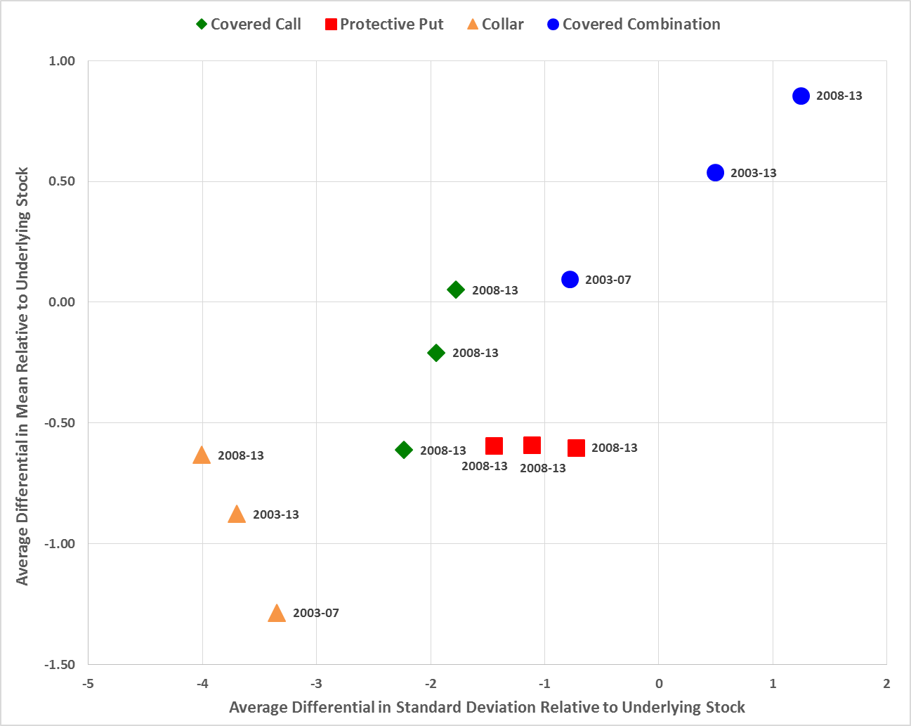
Exhibit 1
Average Differential Means and Standard Deviations of Returns Between Four Option Strategies and the Corresponding Long Equity Strategy for Ten Stocks
(January, 2003 – August, 2013)

Slide 14
Performance Measures
Exhibit 1 provides information regarding risk and return, but it does not explicitly address the issue of whether the risk-return tradeoff is favorable.
To investigate performance, we utilize four popular measures:
  Sharpe ratio
  Jensen’s alpha
  Treynor ratio
  Sortino ratio
We compute these four measures for each of the five strategies and ten stocks.
  For each stock we rank the five strategies from 1 to 5 in terms of decreasing performance.
  We then average the rankings across all ten stocks. Exhibit 2 presents the results.

Slide 15
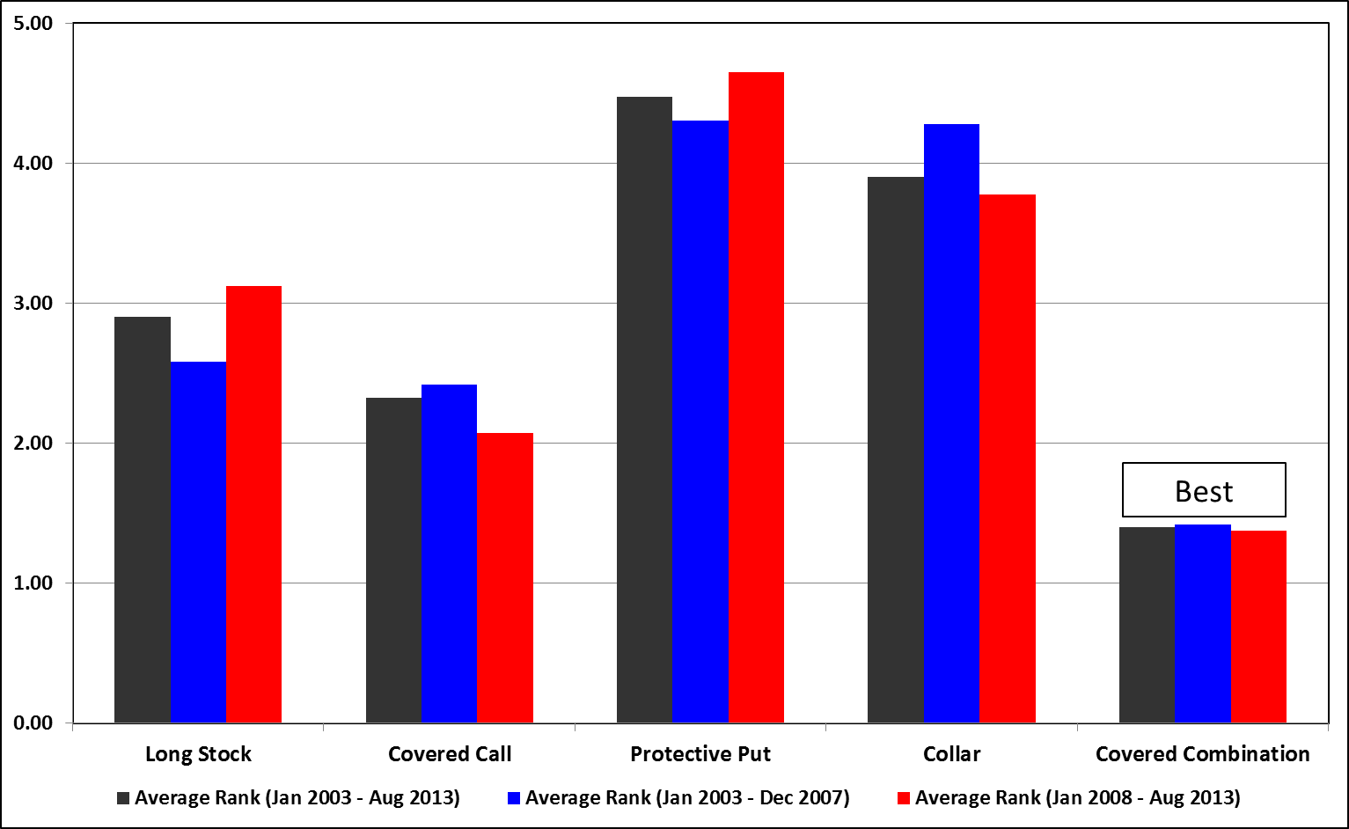
Exhibit 2
Average Rankings of the Relative Performance of Four Option Strategies and the Corresponding Long Equity Strategy for Ten Stocks
(January, 2003 – August, 2013)

Slide 16
Empirical Results
The results of Exhibit 2 are striking in their consistency.
The same general theme holds for the entire period 2003-2013 and both sub-periods 2003-2007 and 2008-2013.
From best to worst, the strategies rank as follows:
  Covered combination
  Covered call
  Long equity
  Collar
  Protective put
Although the consistency of these results is persuasive, there are complicating issues (which we shall address) that prevent these results from being as compelling as one might believe at first glance.

Slide 17
How Do Cumulative Returns Compare
Across These Five Strategies?
Does one get the same relative rankings using cumulative returns as one gets with the aforementioned performance measures?
Exhibit 3 displays the cumulative return results for all five strategies and ten stocks over 2003-2013.
The covered combination dominates by ranking first for all stocks except Google.
The covered call beats long equity for all stocks except Apple, Amazon, and Google.
Overall, the average rankings presented in Exhibit 3 agree with the average rankings summarized in Exhibit 2.

Slide 18
Exhibit 3
Rankings of Performance of Cumulative Returns from Five Strategies for Ten Stocks
(January, 2003 – August, 2013)

Slide 19
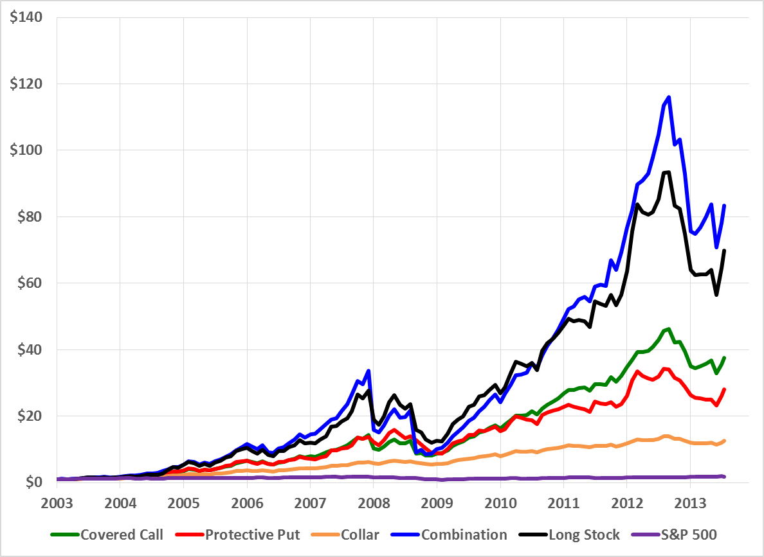
Cumulative Return on a $1 Investment in AAPL
Note the Y-Axis

Slide 20
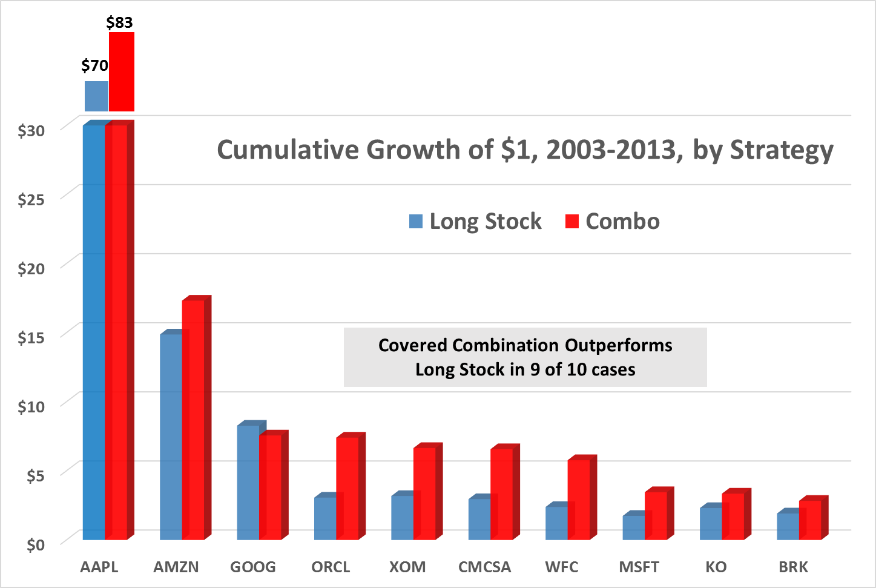

Slide 21
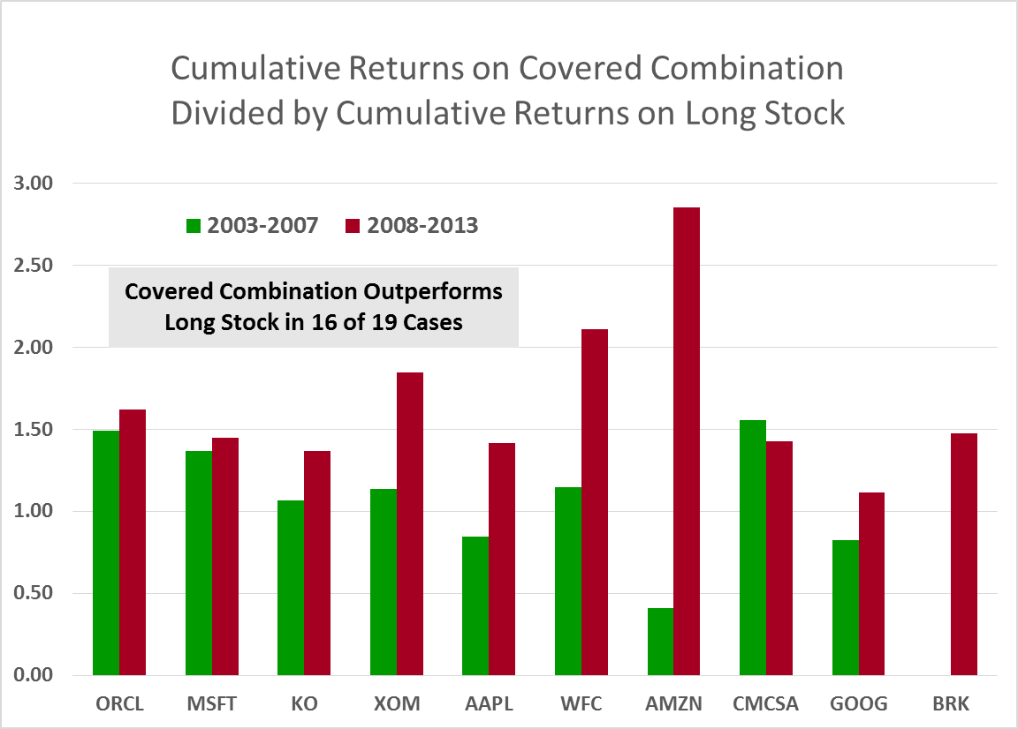

Slide 22
First Complicating Issue:
Transaction Costs
    Consider the covered combination strategy.
    It involves two options positions, and those option positions are rolled over monthly.
    Including transaction costs (i.e., bid-ask spreads) will reduce, or possibly even eliminate, the apparent advantage that the covered combination has over the (already held) long equity position.

Slide 23
Second Complicating Issue:
Non-Normality of Returns
Leland (1999) explores this issue in detail, using a simple example to examine both the covered call and protective put strategies.
Leland demonstrates that using CAPM-based performance measures where there are nonsymmetrical returns will:
  Overrate “rebalancing” strategies (which reduce or “sell” skewness), i.e., covered call
  Underrate “momentum” strategies (which increase or “buy” skewness), i.e., protective put.
His demonstration foreshadows our findings exactly! That is, he predicts:
  The covered call strategy will outperform long equity.
  The protective put strategy will underperform long equity.
Note: Leland’s (1999) examples consider only strategies buying or selling options on the market, but similar results are likely for options on individual securities.

Slide 24
Second Complicating Issue:
Non-Normality of Returns, Cont.
Leland warns: “Any investment manager can ‘game’ the CAPM performance measurement by selling options or rebalancing.”
Leland proposes a performance measure that is robust to non-normality of returns.
Our preliminary investigations suggest that using Leland’s proposed measure does not change the relative rankings of the strategies.
Notes:
Both of these comments are extremely relevant for our study!

Slide 25
Third Complicating Issue:
Early Exercise
Had returns been adjusted for early exercise:
  Strategies involving (only) selling options, like the covered combination and covered call, would obtain lower returns.
  Strategies involving (only) buying options, like the protective put, would obtain higher returns.
Consequently:
  The covered combination and covered call strategies might perform worse than they currently appear to perform (based on Exhibit 2)
  The protective put strategy might perform better than it currently appears to perform (based on Exhibit 2)
  The collar strategy might perform better or worse given that it involves both buying and selling options.
NOTE: Portfolio managers can, if they wish, avoid early exercise by:
  Using stocks that do not pay dividends (short call strategies)
  Using European-style FLEX options (short option strategies).

Slide 26
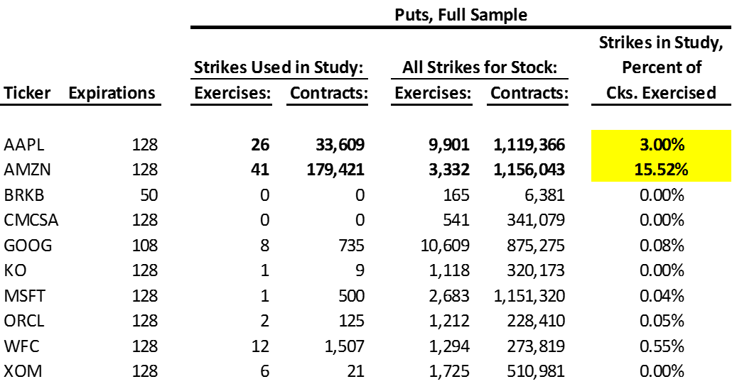
Early Exercise
The OCC and Professor Robert Whaley gave us access to OCC data on early exercise used in Barraclough and Whaley (2012)
Notes:
For the exercises, remember that there are three types of market participants. They are customers, market makers, and proprietary firms.

Slide 27
“Costs of Competition Send Amazon Profit Down 58%” http://www.nytimes.com/2006/07/26/technology/26amazon.html?_r=0
Notes:
Big change on the 26th …. Go across row and mention deltas, intrinsic values, difference
Note exercises in August are irrelevant for our study. Also, note how the exercises dribble on for days, and some contracts are never exercised.
Note also that the number exercised often exceeds open interest! B&W (2012) discuss this.

Slide 28
Summary of Our Results to this Point
Long equity generally outperforms the collar and protective put.
The covered call generally outperforms long equity.
The covered combination generally outperforms long equity.
    Premature to conclude covered combination outperforms long equity in practice.
    The apparently superior performance could reflect the absence of:
      An early exercise adjustment
      transaction costs
    There is also the Leland (1999) critique involving nonsymmetrical returns.
  Further analysis, however, should enable us to provide stronger evidence on the relative rankings of these options-based strategies versus long equity.

Slide 29
Where Do We Go From Here?
We could:
  Increase the number of stocks and lengthen the time period.
  Estimate and incorporate transaction costs.
  Estimate Leland’s (1999) performance measure
    OR alternatives such as Modigliani and Modigliani (1997), Stutzer (2000)
    OR the “manipulation-proof” measure of Ingersoll et al. (2007).
  Adjust returns for early exercise.
The biggest concern for us all remains:
What is the best way to measure the
performance of options-based strategies?!

Slide 30
Questions and Comments?

